Slide 1


nEW child care subsidy: GUIDANCE FOR FAMILIES
June 2018

Slide 2
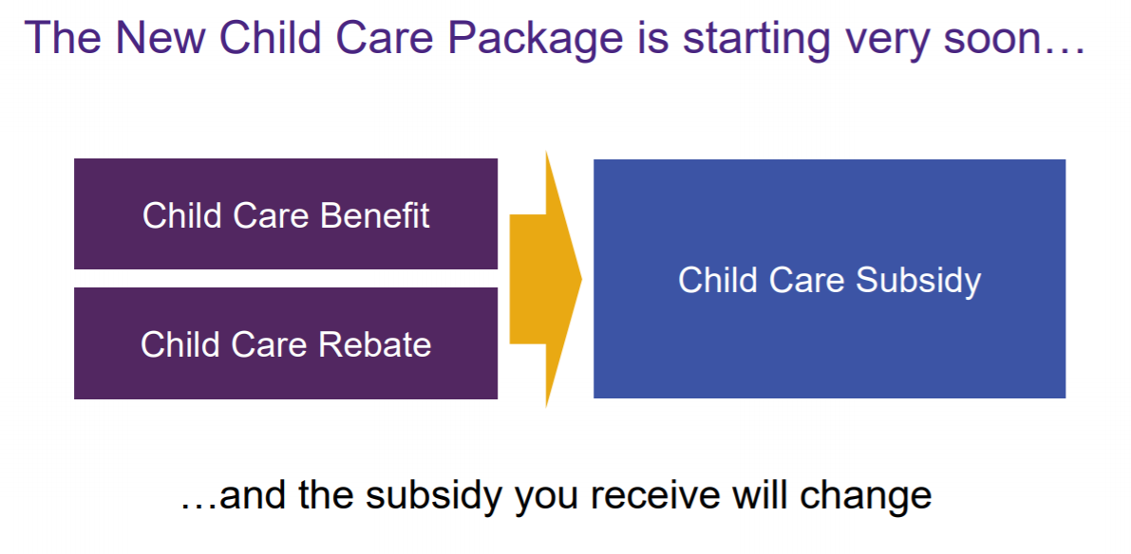

Slide 3


How will your family be affected?
Who Benefits?
Low income working families: Average assistance of low income working families who meet the activity test will rise from 74% to 85% of fees
Additional funding for children with additional needs and children at risk
Who Doesn’t?
Families earning under $65,710 gross will have their base hours of subsidised care cut from 24 hours to 12 hours per week
Families earning $65,710 or more that fail the activity test receive no subsidised care
Families that have a sudden change in workforce participation could immediately be faced with a reduction of hours
Families on incomes of $350K or over will not be eligible to receive any subsidy

Slide 4
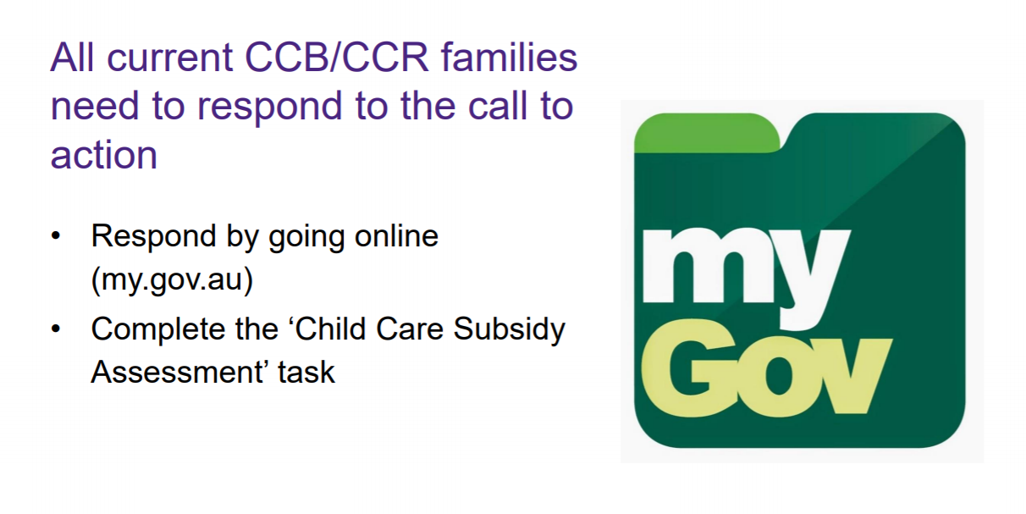
NEW FAMILIES: You will need to create a Centrelink online account, and create a MyGov online account. Read ACA’s guidance at www.bit.ly/CCSNewFamilies to find out how.

Slide 5
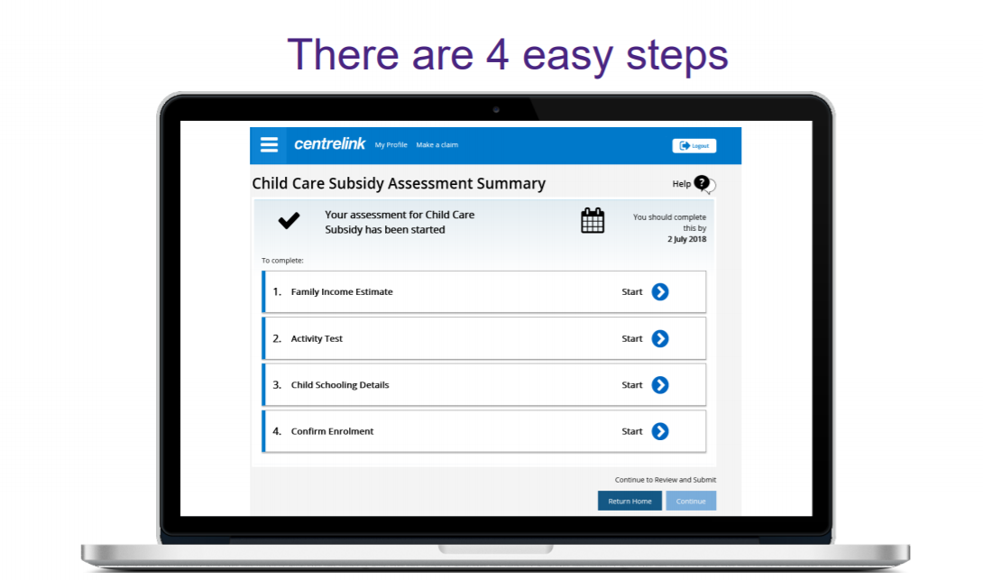

Slide 6
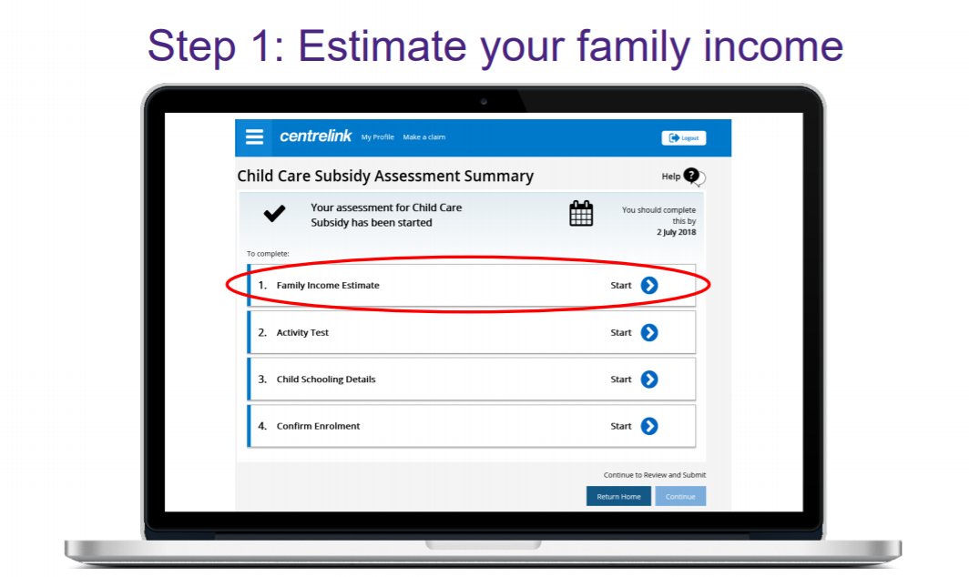

Slide 7
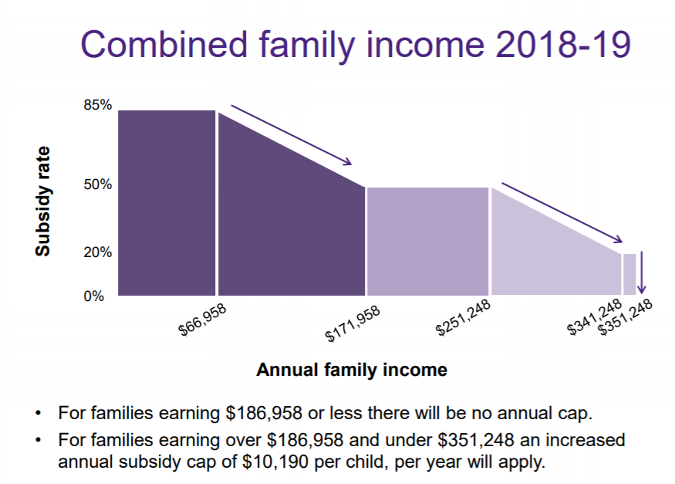

Slide 8
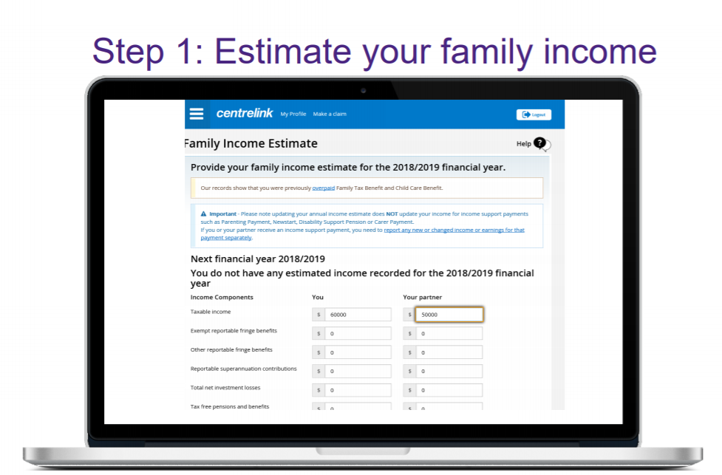

Slide 9
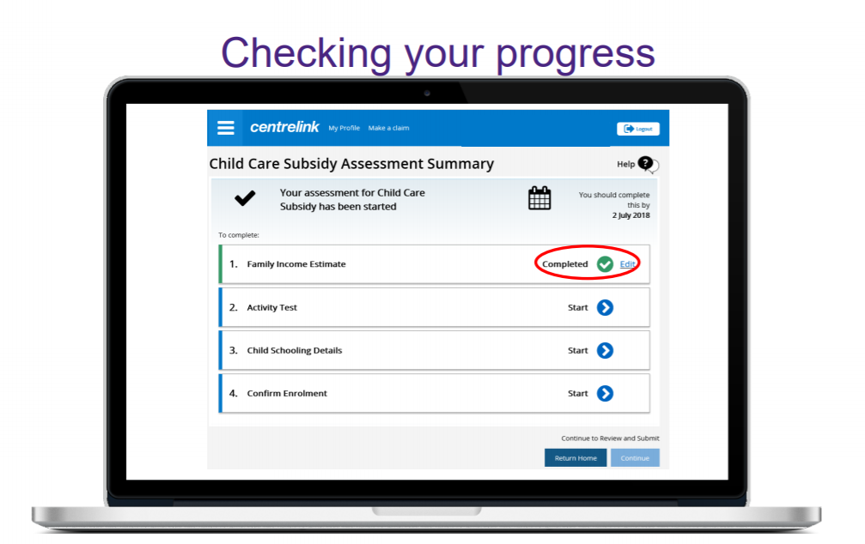

Slide 10
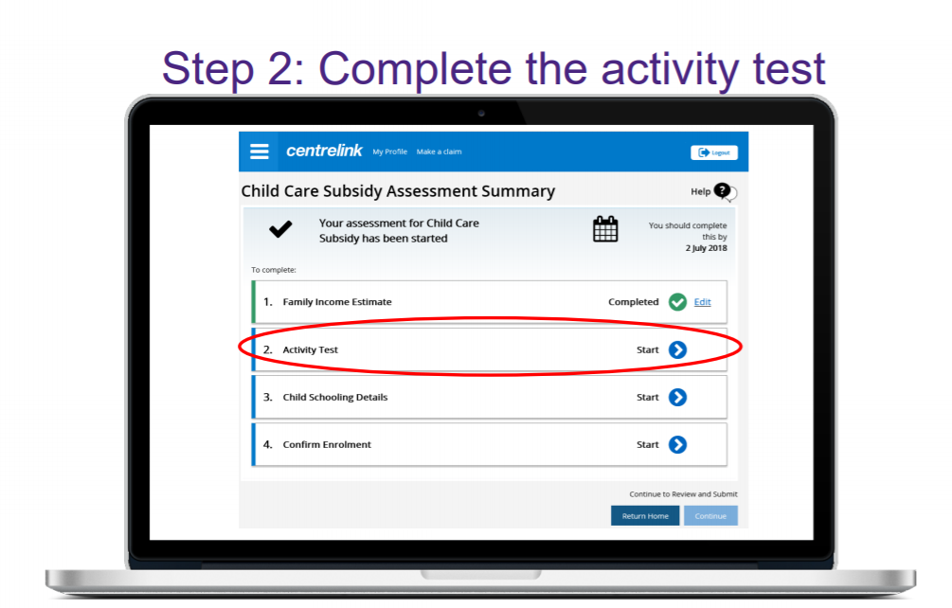
The details you provide in the activity test will determine the number of hours of subsidised early learning (childcare) services to which your family is entitled.

Slide 11
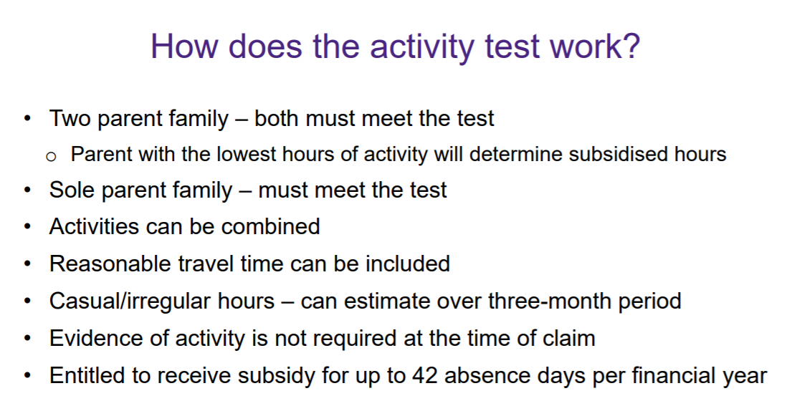

Slide 12
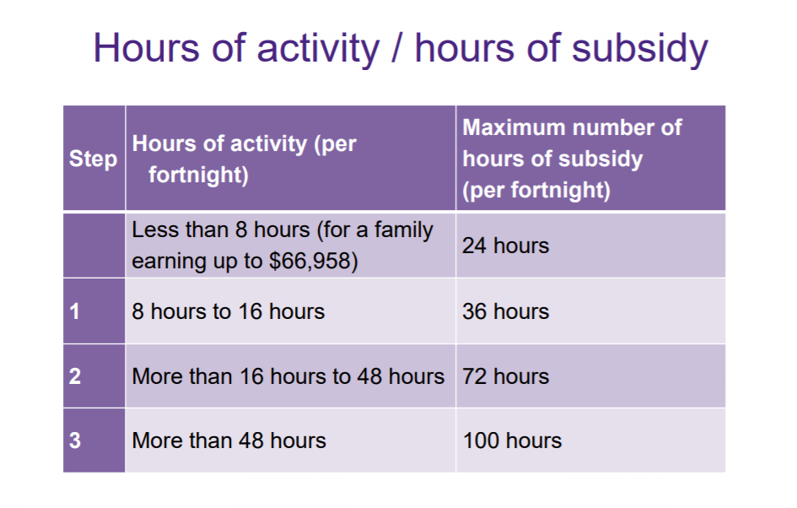
NOTE: If the child attends a kindergarten/preschool program at a centre-based day care (ie. long day care) in the year before they start school, families are entitled to 36 hours of subsidised care per fortnight regardless of activity test.
Put simply the more activity your family undertakes, the more hours of subsidised care you can claim,
so it’s important that you don’t underestimate their anticipated hours or activity.

Slide 13
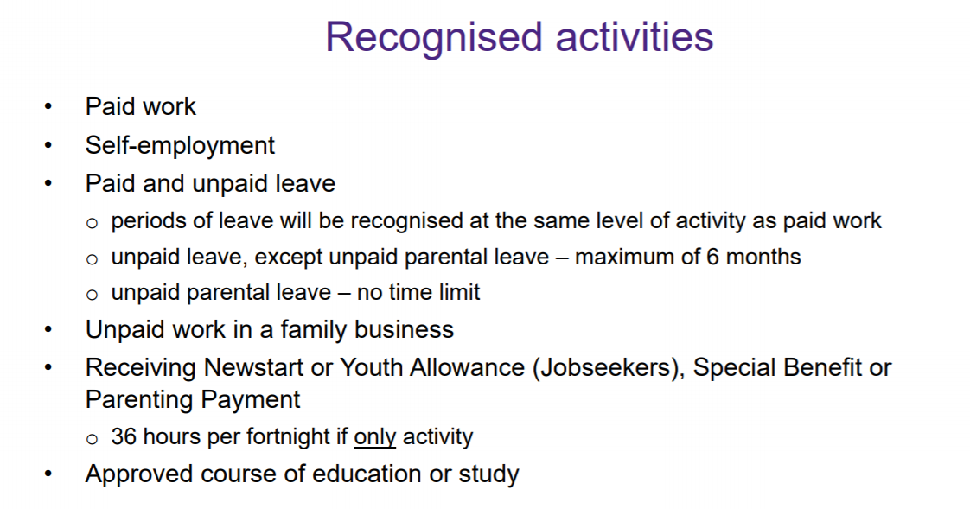

Slide 14
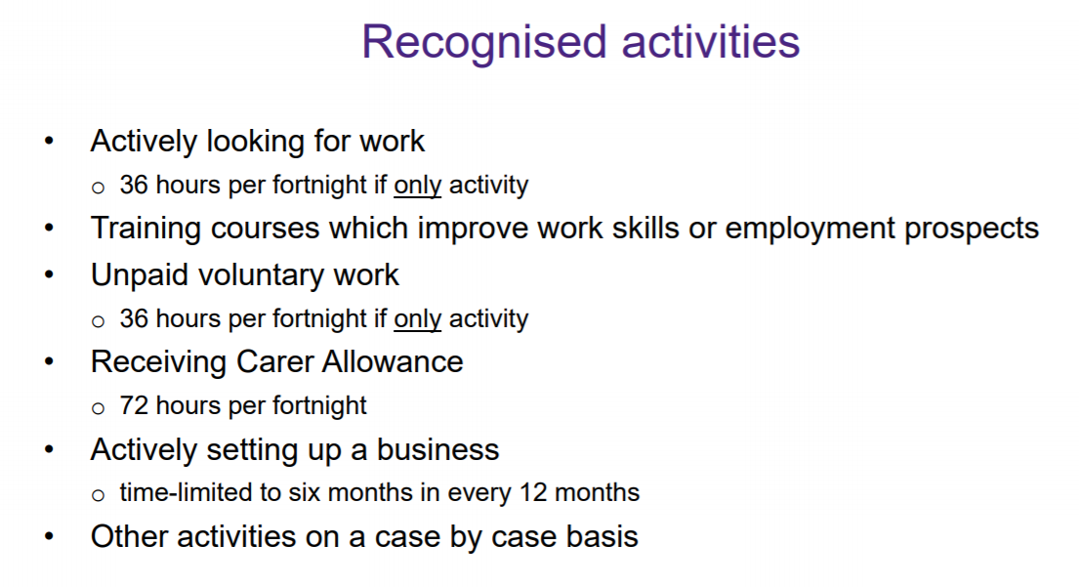

Slide 15
Things to include when completing activity test
Travel time and break times You should include break times as well as the travel time between the child care service and the family member’s place of work, training, study, or other recognised activity in your activity hours total.
For example, in response to the question “How many hours per fortnight do you work?” you should include:
- the hours that you are paid to work;
- your lunch break hours; and
the time it takes to travel from your child’s day care to your place of work.
For example if you worked 3 x 8hr days with an hour lunch break each day and your child’s early learning centre was 30 minute drive you would have 3 x 8hrs (paid employment) + 3 x 1hr (lunch break) + 2 x 30 min trips per day x 3 days to childcare = 30 hrs per week or 60hrs per fortnight.
This also applies to study and volunteer work.

Slide 16
Things to include when completing activity test
Maternity or parental leave
If a family member is on paid or unpaid maternity or parental leave and this is a condition of their employment, this also classifies as recognised activity.
The hours of activity will be the same as what they were immediately prior to commencing parental leave. This means that if a parent was working full time then he/she is still considered to be a full-time employee while on parental leave.
Irregular work hours (eg. Casual labour) or running a small business
If you or your partner work irregular hours or run a small businesses, you can estimate this activity over a three month period. Be sure to count the highest number of hours that you could possibly work in that fortnight, even if that number of hours isn’t required every day. This provides the flexibility to pick up additional hours of work and know that care will be available. If those irregular hours change, you can update them online as required via your myGov account.
Unpaid work
Unpaid work in a family business can include cleaning on a weekend, completing administrative tasks etc.

Slide 17
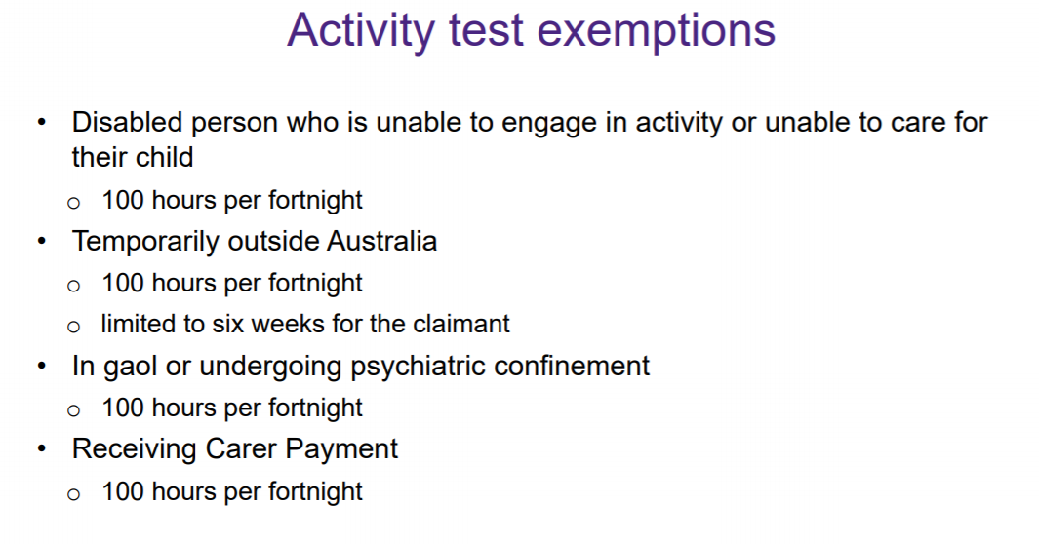

Slide 18
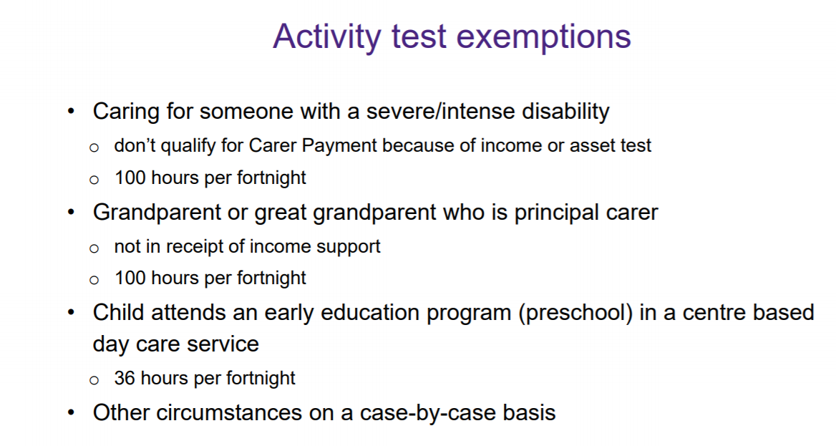

Slide 19
What if your lifestyle doesn’t meet the activity test?
Other activities that do not fall into the recognised activity categories will be assessed by the Government on a case-by-case basis. Families will need to contact Centrelink directly to find out if the activity is supported under the Child Care Subsidy.
If the family earns $66,958 or less a year, and does not meet the Activity Test, they will be still able to access up to 24 hours of subsided care per child per fortnight.
Kindergarten/Preschool programs are exempt from the activity test
Families are entitled to 36 hours of subsidised care per fortnight if the child attends a kindergarten or preschool program at a centre-based day care (ie. long day care) in the year before they start school (that is before grade one of school).

Slide 20
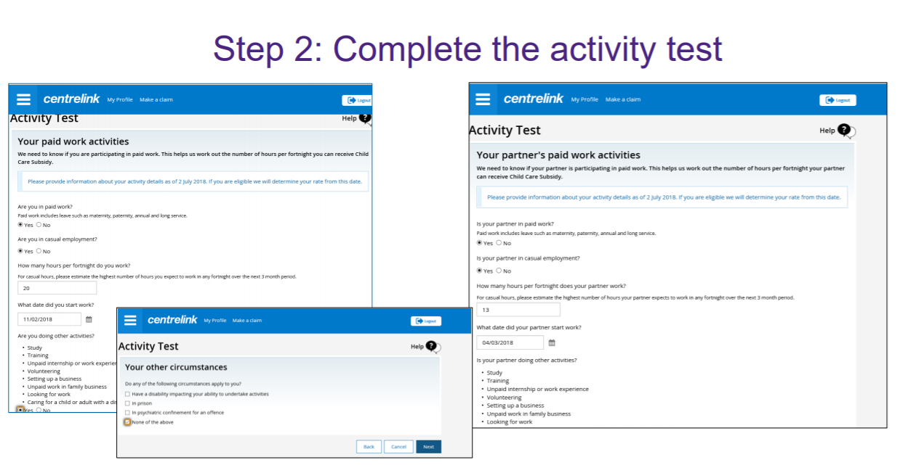

Slide 21
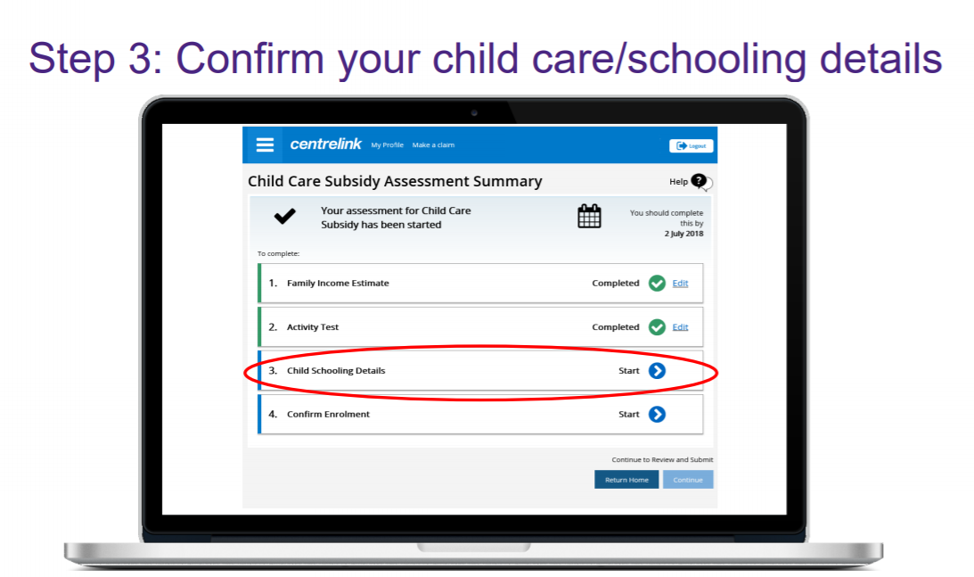

Slide 22
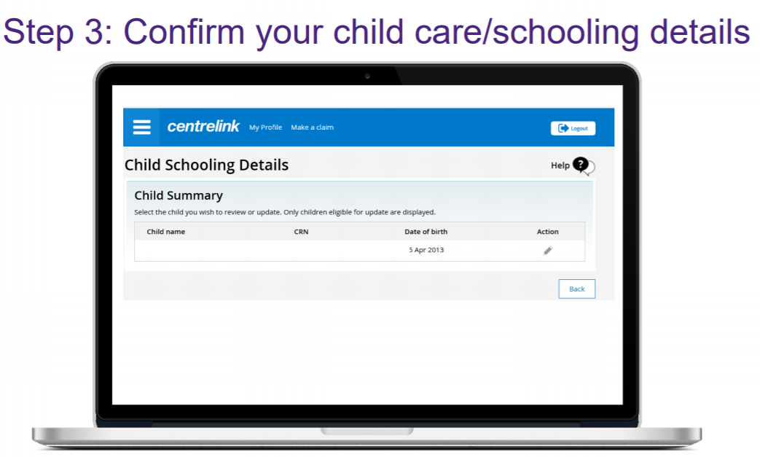

Slide 23
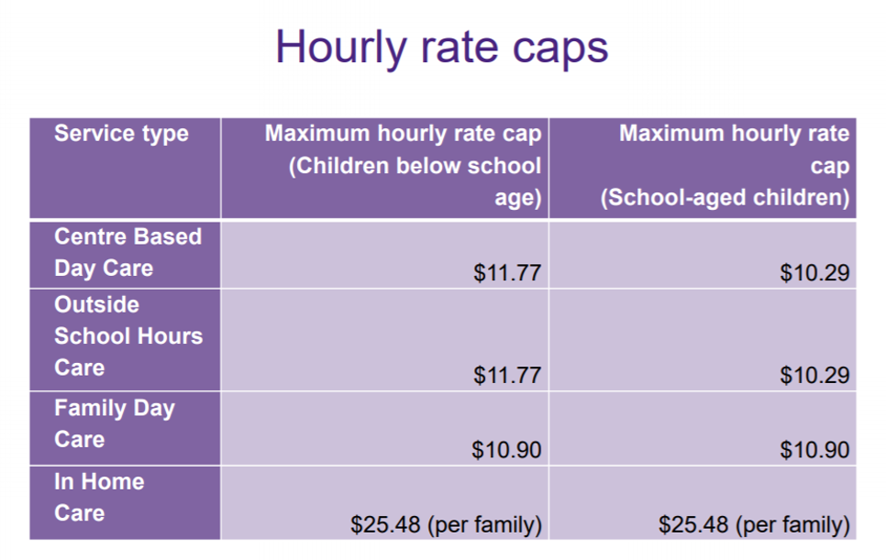
Families will be reimbursed at up to 85% of the actual fee being charged or the hourly fee cap (whichever is lower)
Families will pay any gap in fees charged over the benchmark hourly rate
The different hourly rates reflect the differences in operating costs for different types of early childhood education services
Benchmark hourly rates will be increased by CPI for implementation in July 2018
Type of service you use impacts the hourly rate

Slide 24
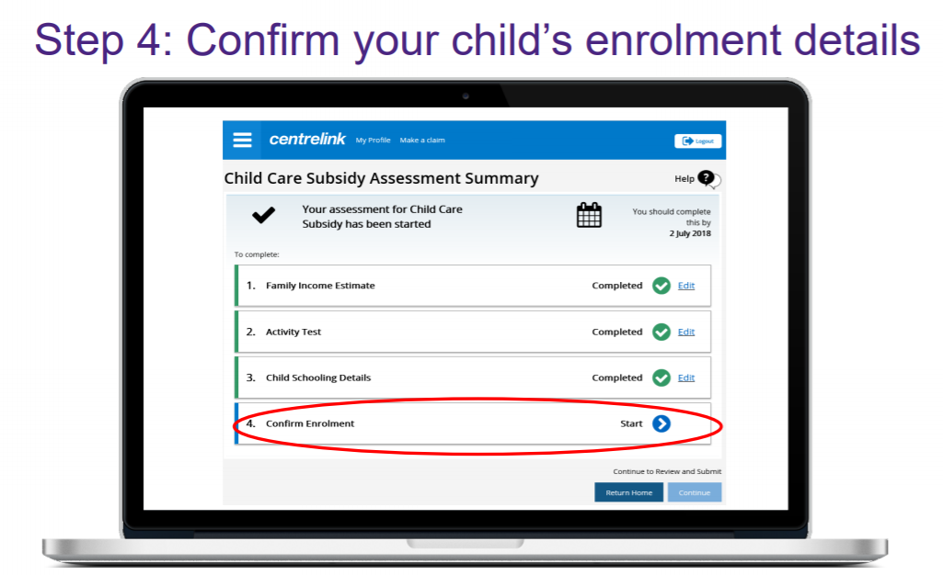
IMPORTANT NOTE: You MUST complete this step in order to receive your rebate.

Slide 25
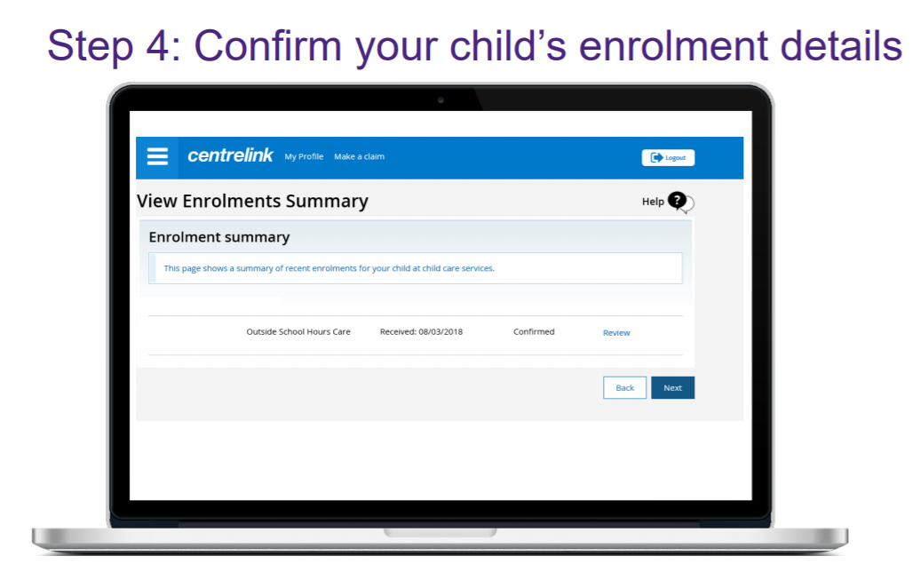

Slide 26
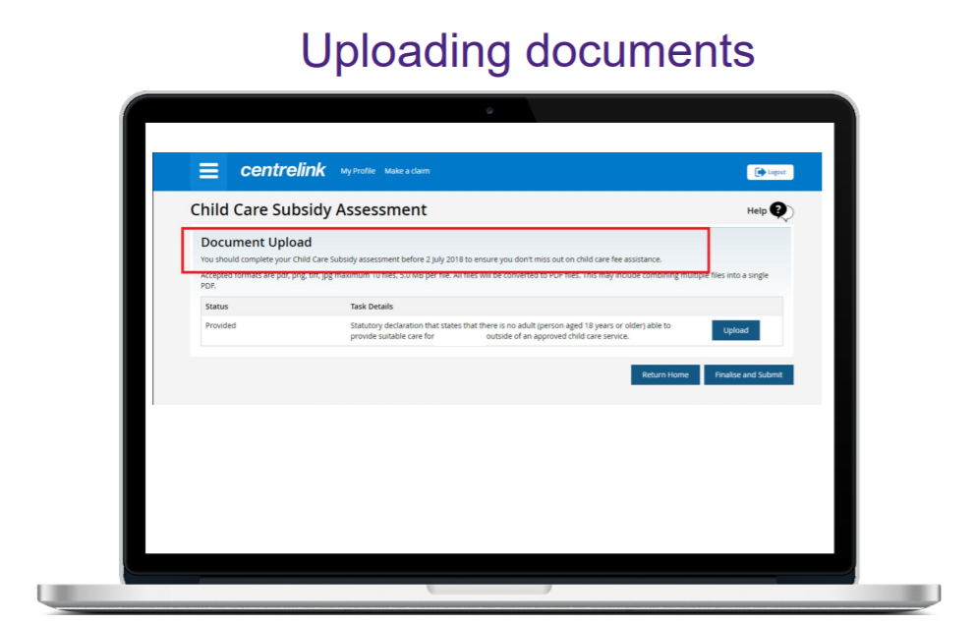

Slide 27
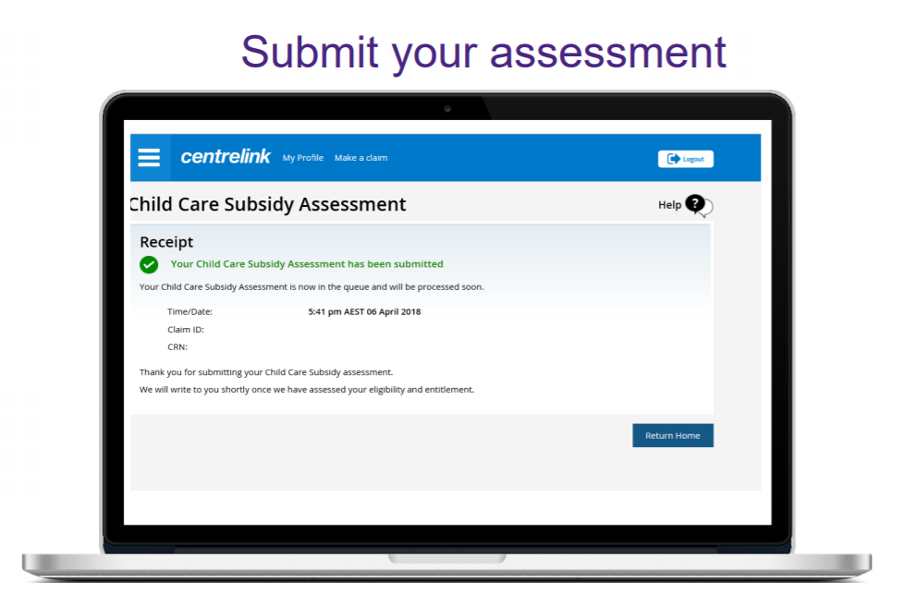

Slide 28
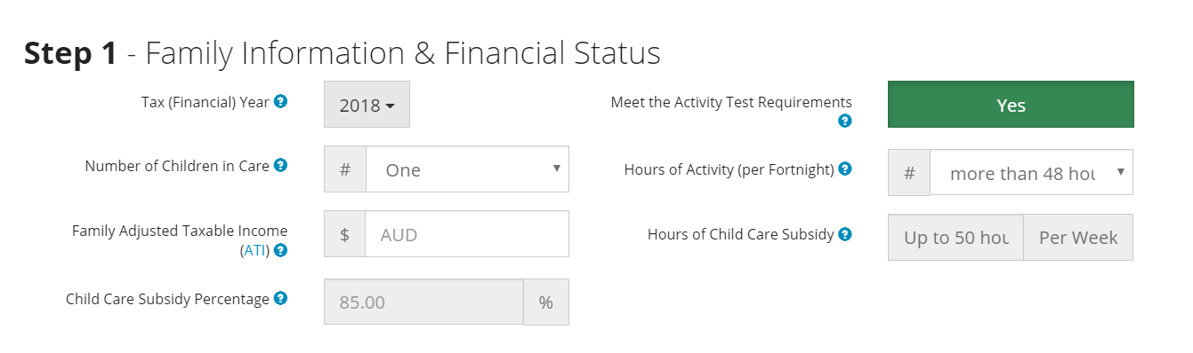
Estimate your new Child Care Subsidy amount
Families can now make use of ACA’s Child Care Subsidy Calculator - a quick and easy alternative to Centrelink's Payment and Service Finder - to estimate their level of fortnightly support and their out-of-pocket “gap” fee under the new Child Care Subsidy (CCS).
The calculator asks families a set of questions about their circumstances, including their shared income and estimated hours of work/study along with the "hourly rate" of their particular early learning service, to provide an estimate of their fortnightly Child Care Subsidy. www.bit.ly/CCSCalculator

Slide 29
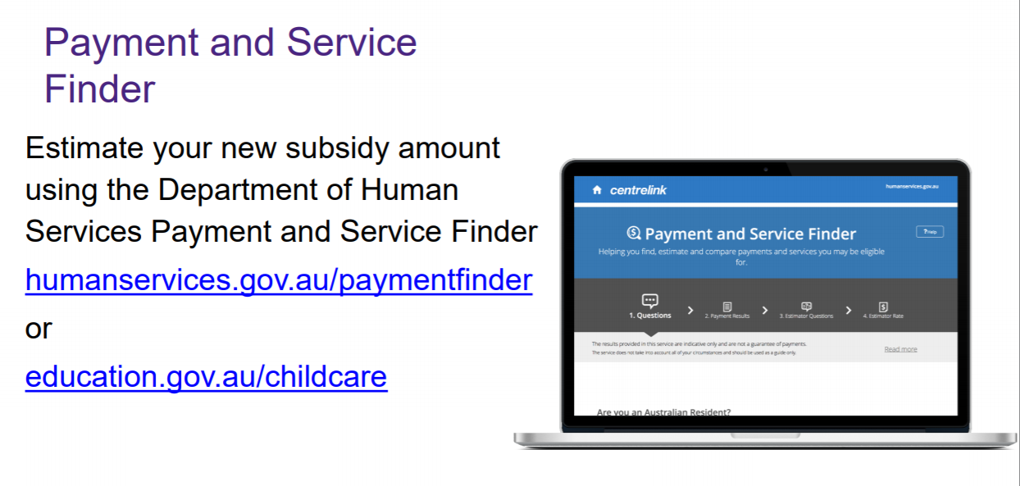
Alternatively you can use the government estimator, which assesses you for other government programs as well.

Slide 30

ADDITIONAL GOVERNMENT SUPPORT

Slide 31

A top up payment in addition to the Child Care Subsidy is available to support vulnerable families and children
Early learning services can apply for funding to improve child wellbeing
For children at risk of serious abuse or neglect
Subsidy equal to 100% of actual fee charged and 120% of CCS hourly rate cap, for up to 100 hours of assistance per fortnight (regardless of family’s income or activity test outcome)
Families can apply (via MyGov)
Grandparent principal carers on income support
Families experiencing temporary financial hardship
Parents transitioning to work from income support
Individuals may be eligible for more than one type of Additional Childcare Subsidy at a time.
You will need to complete an online assessment for Child Care Subsidy.
You will then receive a second letter from Centrelink in June 2018 setting out how to apply for Additional Child Care Subsidy (transition to work).
More information can be found on the Department of Education and Training website – www.education.gov.au/ChildCarePackage
ADDITIONAL child care subsidy

Slide 32
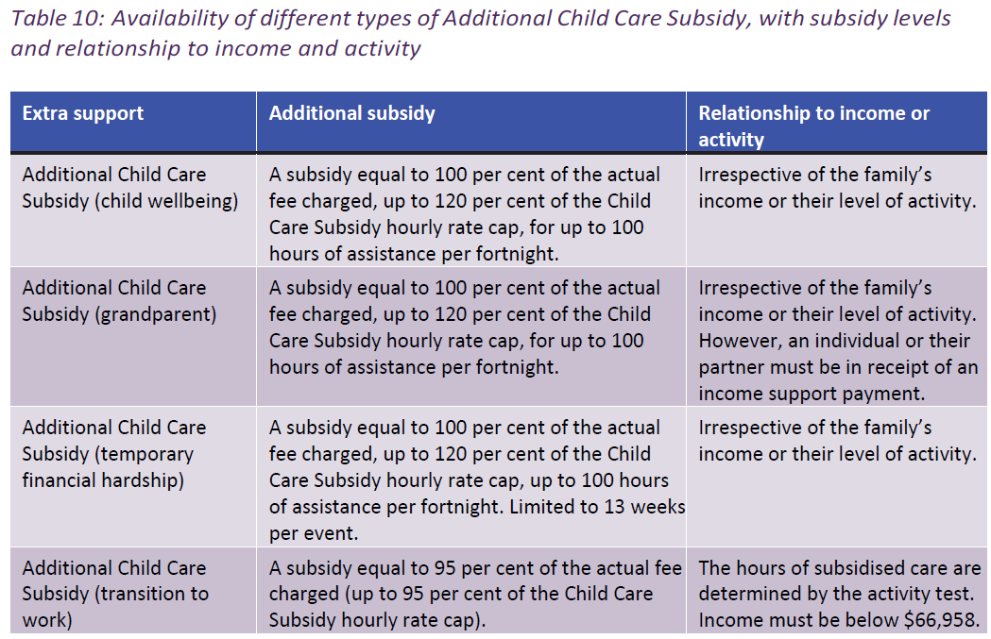

Slide 33
Common questions
What if my work circumstances change?
You can update your details on MyGov at any time and your subsidy amount and eligible hours will change accordingly.
What if I change services?
You can update your early learning service details on MyGov at any time.
Why is 5 per cent of the subsidy withheld?
Because some families are unable to estimate their income accurately, 5 per cent of your weekly Child Care Subsidy entitlement will be withheld. Following reconciliation, if you haven't received enough Child Care Subsidy based on your adjusted taxable income, you will receive a lump sum payment. If you have been paid too much Child Care Subsidy, you will have a debt to repay.

Slide 34
MORE INFORMATION
FAMILIES CCS CHECKLIST – www. bit.ly/CCSFamiliesChecklist
This is a thorough, simply worded checklist that walks you through how to sign up for the new Child Care Subsidy (provided by the Australian Childcare Alliance).
Department of Education - www.education.gov.au/ChildCarePackage
Tel - 1300 566 046
Department of Health and Human Services
www.humanservices.gov.au/individuals/services/centrelink/child-care-subsidy
Tel - 136 150
Online enquiry form: https://www.humanservices.gov.au/individuals/contact-us/message-child-support

