Slide 1

Impacts of the new child care subsidy on FAMILIES
February 2018

Slide 2

Purpose
This document is designed to support Approved Providers members of Australian Childcare Alliance during the implementation of the new Child Care Subsidy (CCS)
It is focused on enhancing Approved Providers understanding of how the new CCS will impact the families and children in their Early Childhood Education and Care (ECEC) service.

Slide 3
contents
Summary of CCS implementation Impacts on Families - Page 4
Single childcare subsidy payment - Page 6
Income thresholds - Page 7
Activity test - Page 9
Benchmark hourly rate - Page 14
Childcare safety net - Page 17
More information - Page 21

Slide 4

Impacts of the Child Care Subsidy
Implementation of the new Child Care Subsidy on 2 July 2018 may impact families due to:
A new single payment subsidy
Revised combined family income thresholds
A new Activity Test
New “hourly rate cap” per service type
New funding for families experiencing difficulty via the Child Care Safety Net
Payments made directly to the ECEC service provider on behalf of the family

Slide 5


SNAPSHOT: CHILD CARE SUBSIDY IMPACT ON FAMILIES
Who Benefits?
Low income working families: Average assistance of low income working families who meet the activity test will rise from 74% to 85% of fees
Additional funding for children with additional needs and children at risk
Who Doesn’t?
Families earning under $65,710 gross will have their base hours of subsidised care cut from 24 hours to 12 hours per week
Families earning $65,710 or more that fail the activity test receive no subsidised care
Families that have a sudden change in workforce participation could immediately be faced with a reduction of hours
Families on incomes of $350K or over will not be eligible to receive any subsidy

Slide 6
How IS THE LEVEL OF CHILD CARE SUBSIDY determined for each family?
Three things will determine how much subsidy a family receives:
- Combined family income
- How much the parents work, based on the activity of the parent who works least (This is determined via the “Activity Test”)
- The type of childcare service the family uses

Slide 7
* Subsidy rate of actual fee charged or MAXIMUM HOURLY RATE CAP (WHICHEVER IS LOWER)
Combined Family Income | Subsidy rate*
Up to $65,710 | 85%
> $65,710 to < $170,710 | Tapering to 50%
$170,710 < $250,000 | 50%
$250,000 < $340,000 | Tapering to 20%
$340,000 < $350,000 | 20%
$350,000+ | 0%
Subsidy tapers by 1% for each $3,000 of family income

Slide 8
Activity Test REQUIREMENTS
Two parent family
both must meet the test, though some exemptions apply (eg; families that are eligible for the child care safety net)
activities can be combined
the parent with the lowest entitlement will determine subsidised care hours
Sole parent family
must meet the test
Casual/irregular hours of care
can estimate over 3-month period but need to notify changes

Slide 9
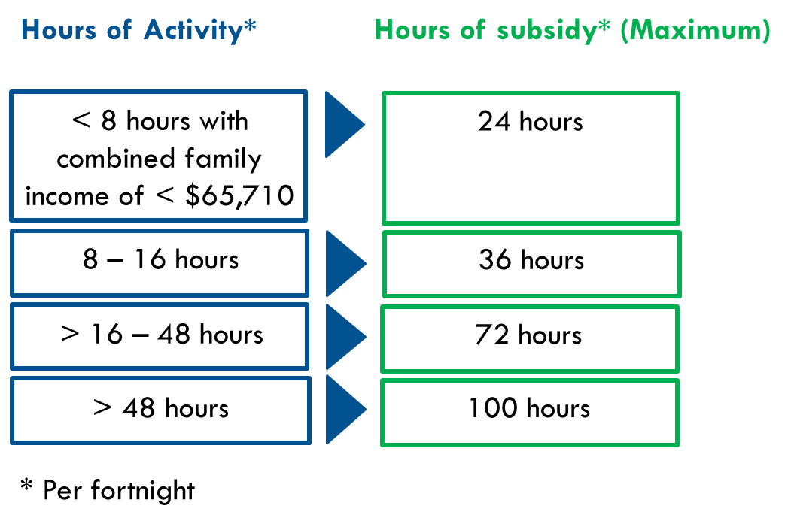
Activity LEVEL OF BOTH PARENTS WILL IMPACT ACCESS

Slide 10

TYPE OF SERVICE impacts hourly rate
Families will be reimbursed at up to 85% of the actual fee being charged or the hourly fee cap (whichever is lower)
Families will pay any gap in fees charged over the benchmark hourly rate
The different hourly rates reflect the differences in operating costs for different types of early childhood education services
Benchmark hourly rates will be increased by CPI for implementation in July 2018
Service Type | Max hourly fee cap
Centre based long day care | $11.55
Family day care | $10.70
Outside school hours care | $10.10

Slide 11

IMPACT OF NEW Child care SUBSIDY on families
Families earning < $65,710
- Will receive a subsidy of 85% of the actual fee charged subject to hourly rate cap
Families earning $170,710 to $250,000
- Will receive a reduced subsidy of 50%
Families earning $350,000
- Will receive a reduced subsidy of 20%
Families earning > $350,000
- Will receive zero subsidy, but may be entitled to additional child care subsidy

Slide 12
Activity Test – MORE DETAIL
Approved activities can be combined to determine the maximum hours of subsidy
Time taken to travel between the child care service and the parents/carers place of work, training, study, or other approved activity is included
Activity hours do not need to coincide with child care hours, for example an individual undertaking work on the weekends will be eligible for child care subsidy during the week
It is important that families don’t under-estimate their activity so that they receive their full subsidy entitlement
To find out more visit: www.education.gov.au/child-care-subsidy-activity-test

Slide 13
Activity Test – What Activities Count?
The following activities meet the activity test requirements:
Paid work
Being self employed
Doing unpaid work in a family business
Setting up a business (6 month time limit)
Looking for work
Volunteering
Studying
Families earning < $65,710 per annum who don’t meet the activity test will be able to access 24 hours of standardised care per fortnight without having to meet the Activity Test under the Child Care Safety Net
https://www.education.gov.au/child-care-subsidy-activity-test

Slide 14
Activity Test – PROPOSED EXEMPTIONS
The following activities meet the activity test requirements:
Receiving Disability Support Pension
In jail or undergoing psychiatric confinement
Receiving Carer Payment
Care for someone with a severe/intense disability
Other circumstances on a case-by-case basis
Exemptions subject to finalisation of Ministerial rules

Slide 15
HOURLY FEE CAP IN PRACTICE
Hourly rate cap = $11.55

Slide 16
Families can estimate their child care subsidy
Estimate what new subsidy might be
Compare to current benefit/rebate
Estimator at www.bit.ly/CCSEstimator
OR click HERE

Slide 17

Child care safety net
Progressively rolled out from July 2016 and includes:
Additional Child Care Subsidy
Community Child Care Fund
Inclusion Support Programme

Slide 18

Additional Child Care Subsidy
A top up payment in addition to the Child Care Subsidy is available to support vulnerable families and children
Services can apply for funding to improve child wellbeing
Children at risk of serious abuse or neglect
Families Can Apply
Grandparent principal carers on income support
Families experiencing temporary financial hardship
Parents transitioning to work from income support
More information can be found on the Department of Education and Training website HERE

Slide 19
Community Child Care Fund (CCCF)
Child care services could apply for supplementary grant funding:
Reduce barriers in accessing child care
Focus on disadvantaged or vulnerable families and communities
Sustainability support for child care services experiencing viability issues
Capital support to increase supply of child care places in areas of high unmet demand
Open to both private and community services
Please note that the deadline for this funding expired on 30 November 2017

Slide 20
INCLUSION SUPPORT PROGRAMME
Commenced 1 July 2016
Contracted to deliver support services:
Seven Inclusion Agencies
One Inclusion Development Fund Manager
Find out more HERE

Slide 21
For more information
Federal Department of Education
https://www.education.gov.au/ChildCarePackage
1300 566 046
Online enquiry form: https://www.education.gov.au/feedback-and-enquiry-form
Federal Department of Health and Human Services
https://www.humanservices.gov.au/individuals/services/centrelink/child-care-subsidy
136 150
Online enquiry form: https://www.humanservices.gov.au/individuals/contact-us/message-child-support

Slide 22





For more information
Contact your State Australian Childcare Alliance office:
www.nsw.childcarealliance.org.au
02 9683 5438
nsw@childcarealliance.org.au
www.qld.childcarealliance.org.au
07 3808 2366
qld@childcarealliance.org.au
www.sa.childcarealliance.org.au
0407 580 645
sa@childcarealliance.org.au
www.vic.childcarealliance.org.au
03 9532 2017
vic@childcarealliance.org.au
www.wa.childcarealliance.org.au
08 9321 3159
wa@childcarealliance.org.au

