Slide 1

Impacts of the new child care subsidy ON APPROVED PROVIDERS
February 2018

Slide 2
Table of contents
Key features of the new Child Care Subsidy (CCS) - Page 3
Impact summary of new CCS on Approved Providers - Page 8
  Questions and support for families - Page 9
  New technology system - Page 13
  New reporting requirements - Page 15
  Staff training - Page 17
  Financial implications - Page 19
More Information - Page 24

Slide 3

KEY FEATURES OF THE CCS

Slide 4
Most FAMILIES will benefit from ccs implementation
  $37B in funding over 4 years, an increase of $2.5B per annum
  Single subsidy paid direct to ECEC services on behalf of families
  Three things will determine how much subsidy a family receives:
    Combined family income
    How much the parents work, based on the activity of the parent who works least
    The type of childcare service the family uses

Slide 5
* Subsidy rate of actual fee charged or MAXIMUM HOURLY RATE CAP (WHICHEVER IS LOWER)
Combined Family Income | Subsidy Rate*
Up to $65,710 | 85%
> $65,710 to < $170,710 | Tapering to 50%
$170,710 < $250,000 | 50%
$250,000 < $340,000 | Tapering to 20%
$340,000 < $350,000 | 20%
$350,000+ | 0%
Subsidy tapers by 1% for each $3,000 of family income

Slide 6
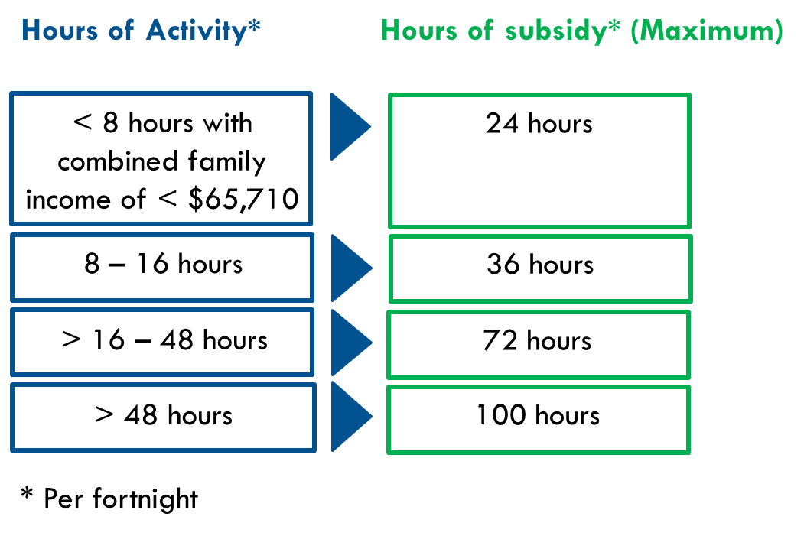
Activity LEVEL OF BOTH PARENTS WILL IMPACT ACCESS
  Two parent family
  both must meet the test, though some exemptions apply
  (eg; families that are eligible for the Child Care Safety Net)
  activities can be combined
  the parent with the lowest entitlement will determine subsidised care hours
  Sole parent family
  must meet the test
  Casual/irregular hours of care
  can estimate over 3-month period but need to notify changes

Slide 7
Type of service
  A family’s level of Child Card Subsidy support is also determined by the type of child care the family uses.
  It will be calculated by the hour, using an hourly rate cap:
  Centre-based care - $11.55^ per hour
  Family Day Care - $10.70^ per hour
  Outside School Hours Care - $10.10^ per hour
Hourly rate cap varies depending on type of service

Slide 8
HOURLY FEE CAP IN PRACTICE

Slide 9

Impacts of the Child Care Subsidy: AN OVERVIEW
Implementation of the new Child Care Subsidy on 2 July 2018 will impact Approved Providers in numerous ways…
Things to Plan For include:
Additional Questions from Families
    Changes to subsidy, plus “benchmark hourly cap”
Technology System Changes
    New Government technology system to support CCS
New Reporting Requirements
    New detailed attendance reporting requirements
Additional Staff Training
    Funding and policy changes and family engagement
Financial Implications for Approved Providers
    Affordability and accessibility issues for some families
    Introduction of a new “benchmark hourly cap”
    Option to introduce sessional care for any families with an income of $65,710 or less a year

Slide 10

Things to plan for: IMPACT ON FAMILIES
  Families will be impacted in different ways by the new CCS
  Be ready for questions on CCS policy rules and their impact on your families
  Implications:
  Approved Providers should be actively familiarising themselves with the new CCS
  Resources:
  ACA Fact Sheet For Families – New Child Care Subsidy
  Federal Department of Education website –
  www.education.gov.au/child-care-subsidy-1

Slide 11

families that benefit most…
  Average assistance of low income working families who meet the activity test will rise from 74% to 85% of fees
  More funding for children with additional needs and children at risk

Slide 12

Families that are negatively impacted
  Families who do not meet the activity test earning $65,710 gross or less will have their base hours of subsidised care cut from 24 hours to 12 hours per week
  Families who do not meet the activity test earning over $65,710 will receive no subsidised care
  Families that have a sudden change in workforce participation could immediately be faced with a reduction of hours
  Families on combined incomes of $350K or more will receive no subsidy

Slide 13

NEW TECHNOLOGY SYSTEM

Slide 14
Things to plan for: New I.T SYSTEM
  A new child care I.T system, is currently being built to support implementation of CCS
  System will be built in the SAP environment
  Third party software will still be used to access the new I.T system
  Implications:
  Final CCMS statements will require adjustment
  Check that your software technology provider is registered to access the CCS
  If you are not currently using a software platform, benchmark and select a solution
  Why? – New attendance reporting requirements (see slide 16)

Slide 15

NEW REPORTING REQUIREMENTS

Slide 16

Things to plan for:
New attendance reporting requirements
  There will be new online CCS reporting requirements
  Mandatory reporting of children’s detailed attendance records
  This can be done via an electronic solution, or entered manually into your software
  A 28-day limit on backdating children’s attendance records
  Implication:
  Approved Providers must consider the practical implications of installing hardware and having access to such systems from their current software provider
  It is also important to consider the challenges with transitioning families to a new system in the lead up to the introduction of these changes.
  Resource:
  You can check which IT service providers are registered to access the CCS at www.docs.education.gov.au/node/3300

Slide 17

STAFF TRAINING

Slide 18
STAFF TRAINING
  The introduction of the CCS on 2 July 2018 is a massive change for the sector
  Staff will be under increased pressure, particularly those accountable for:
    Working with the new technology system
    Reporting attendance records
    Responding to questions from families
    Monitoring financial outcomes
Implication:
  Approved Providers should be engaging their staff and training them on the key aspects of the new CCS, and their individual process changes, to avoid service disruption

Slide 19

FINANCIAL IMPLICATIONS FOR APPROVED PROVIDERS

Slide 20
Financial impacts on approved providers
  Families that fail to meet the activity test may be unlikely to privately fund attendance
  Families earning less than $65,710 that don’t meet the activity test may not elect to increase their funded hours from 12 to 24
  Families earning over $350K may not elect for high utilisation as their subsidies are 100% cut
  Families that are asked to pay above the benchmark fee rate may not be willing to pay the gap
    Implications:
    Approved Providers are advised to closely examine the potential financial impact of the CCS on their families in order to understand their future charging practices
    Resources:
    Please refer to the next slide.

Slide 21
FINANCIAL IMPLICATIONS: Resources
Financial analysis / data model scenarios
  The Department of Education and Training has compiled a suite of business support tools and resources to help child care services to review their business operations in the context of transitioning to the new child care package on 2 July 2018.
  These include key financial and business planning tools and resources that will be useful for all care types and service type.
  They are available at www.education.gov.au/new-business-support-tools-and-resources-child-care-services
  ACA will provide some additional guidance materials to help ECEC services in the coming months.

Slide 22

more INFORMATION

Slide 23





more information
Contact your State Australian Childcare Alliance office:
www.nsw.childcarealliance.org.au
02 9683 5438
nsw@childcarealliance.org.au
www.qld.childcarealliance.org.au
07 3808 2366
qld@childcarealliance.org.au
www.sa.childcarealliance.org.au
0407 580 645
sa@childcarealliance.org.au
www.vic.childcarealliance.org.au
03 9532 2017
vic@childcarealliance.org.au
www.wa.childcarealliance.org.au
08 9321 3159
wa@childcarealliance.org.au

Slide 24
more information
Federal Department of Education
https://www.education.gov.au/ChildCarePackage
1300 566 046
Online enquiry form: https://www.education.gov.au/feedback-and-enquiry-form
Federal Department of Health and Human Services
https://www.humanservices.gov.au/individuals/services/centrelink/child-care-subsidy
136 150
Online enquiry form: https://www.humanservices.gov.au/individuals/contact-us/message-child-support

